Slide 1
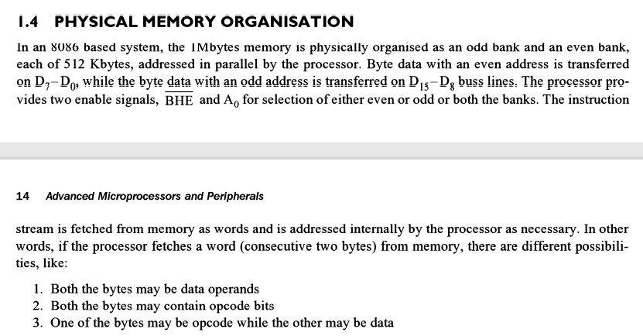

Slide 2
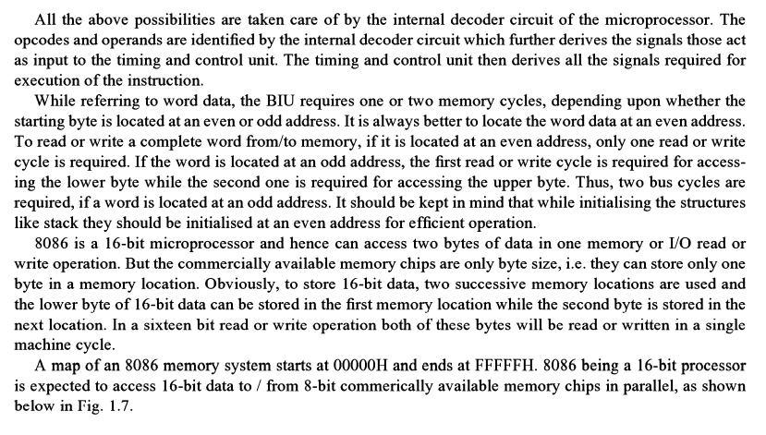

Slide 3
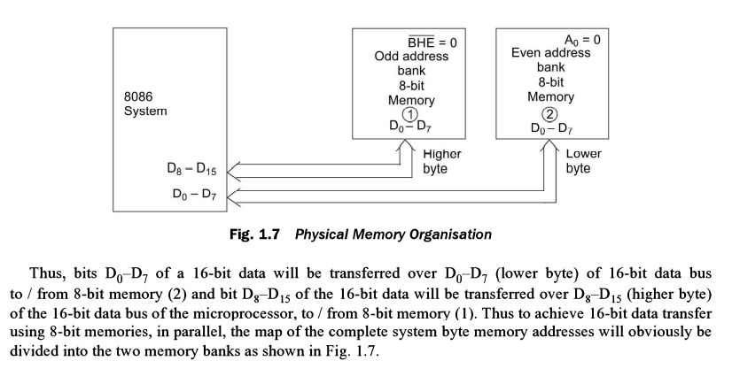

Slide 4
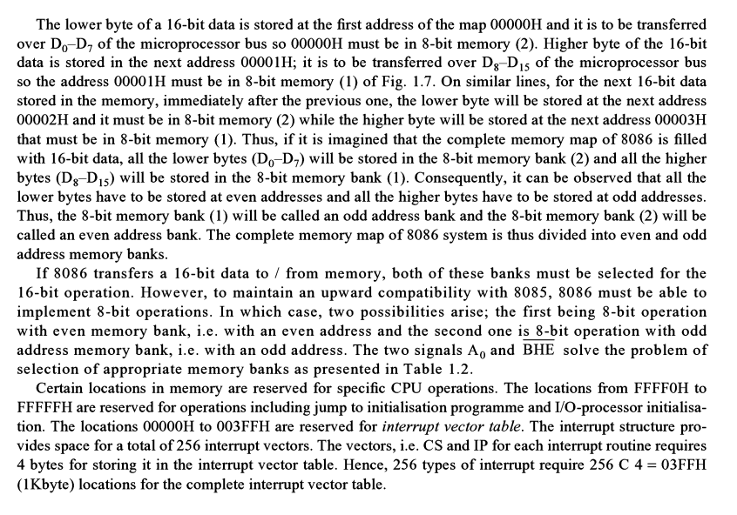

Slide 5
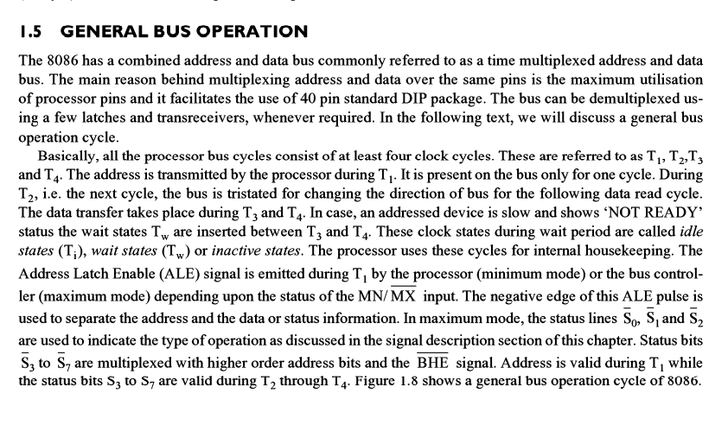

Slide 6
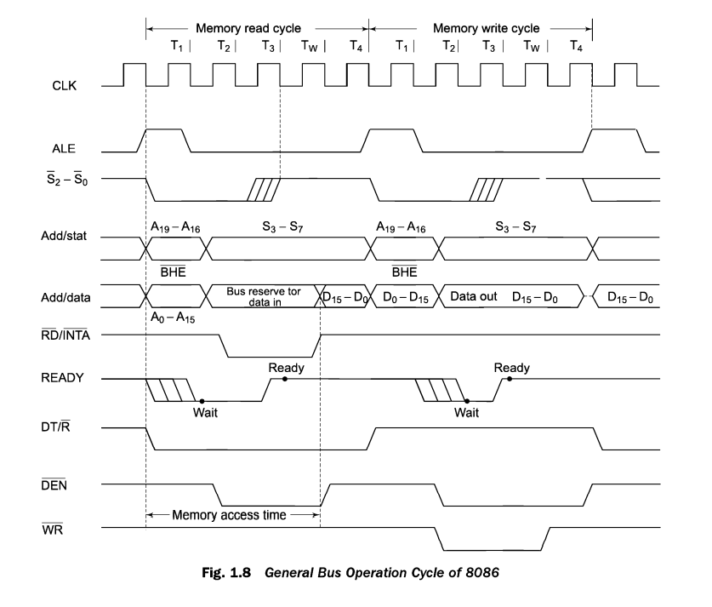

Slide 7
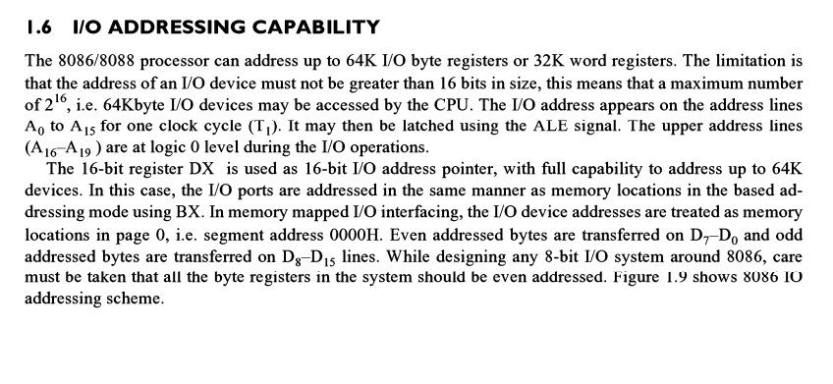

Slide 8
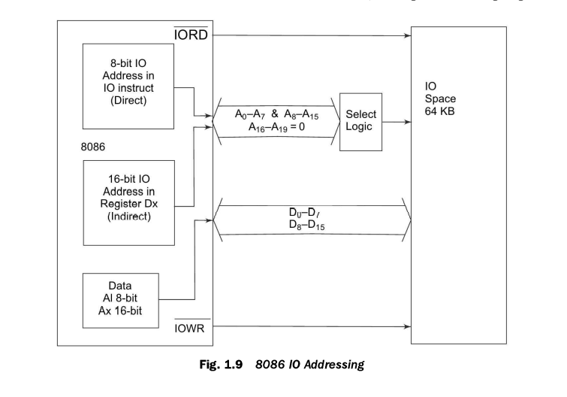

Slide 9
System Timing Diagrams
T-State:
One clock period is referred to as a T-State
T-State
An operation takes an integer number of T-States
CPU Bus Cycle:
A bus cycle consists of 4 or more T-States
T1
T2
T3
T4

Slide 10
Wait and Idle States
• Idle State
– No bus activity required
– Each is 1 clock period long
– Occurs when instruction queue is full or the MPU does not need to read/write to memory
• Wait State
– Triggered by events external to MPU
– Buffer full will trigger a wait state
– Triggered by READY pin
– Inserted between T3 and T4

Slide 11
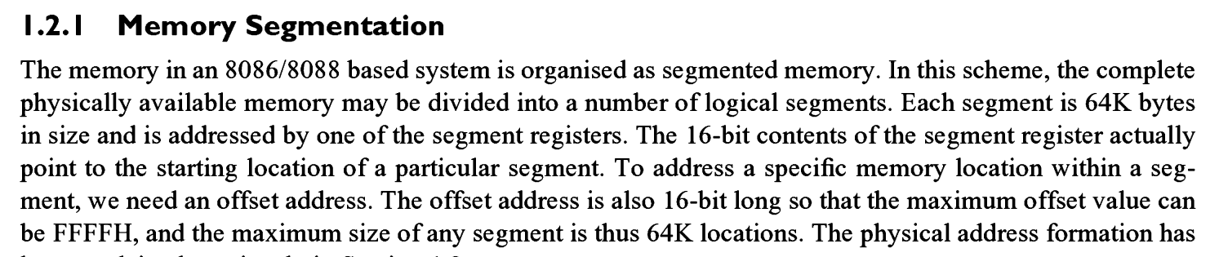

Slide 12
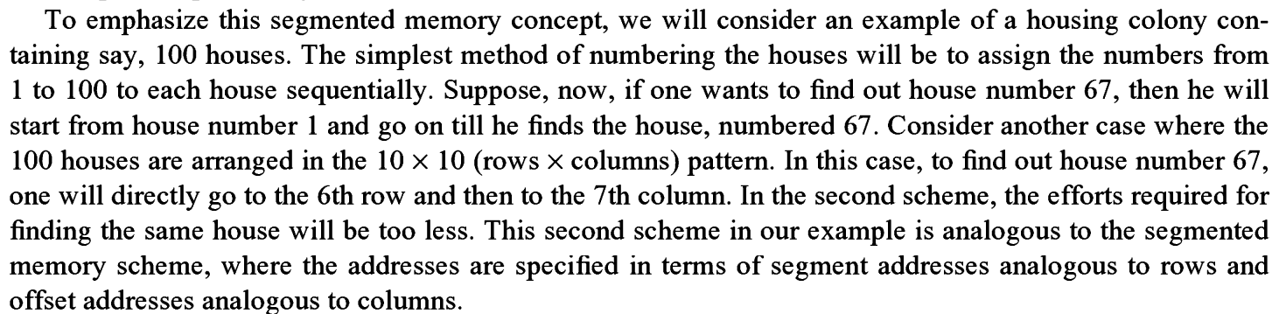

Slide 13
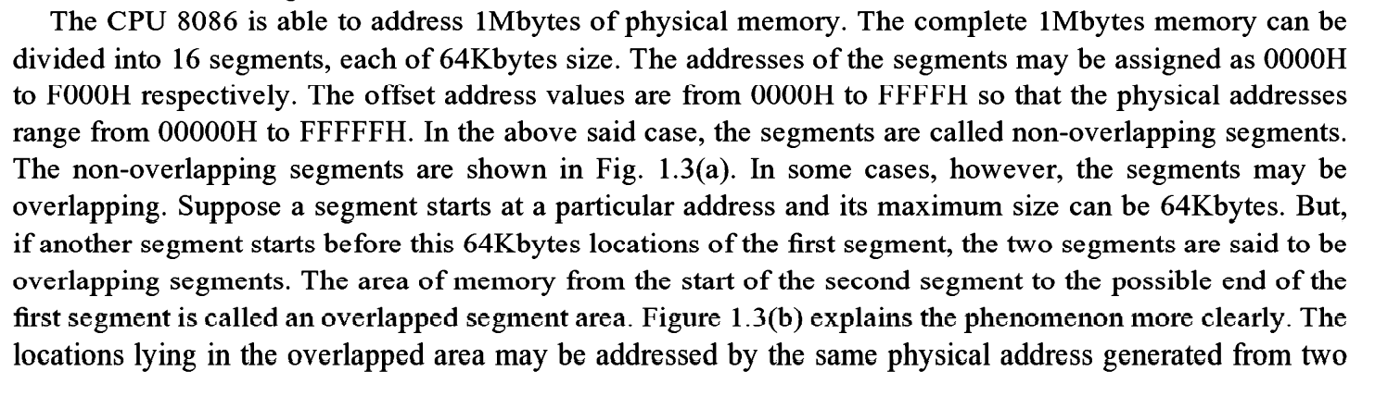

Slide 14
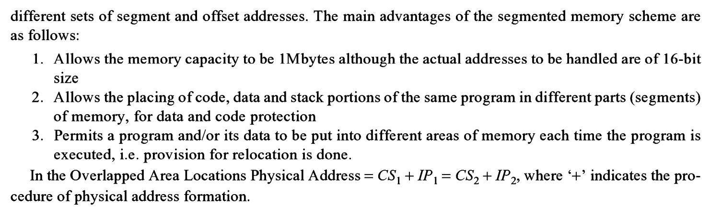

Slide 15
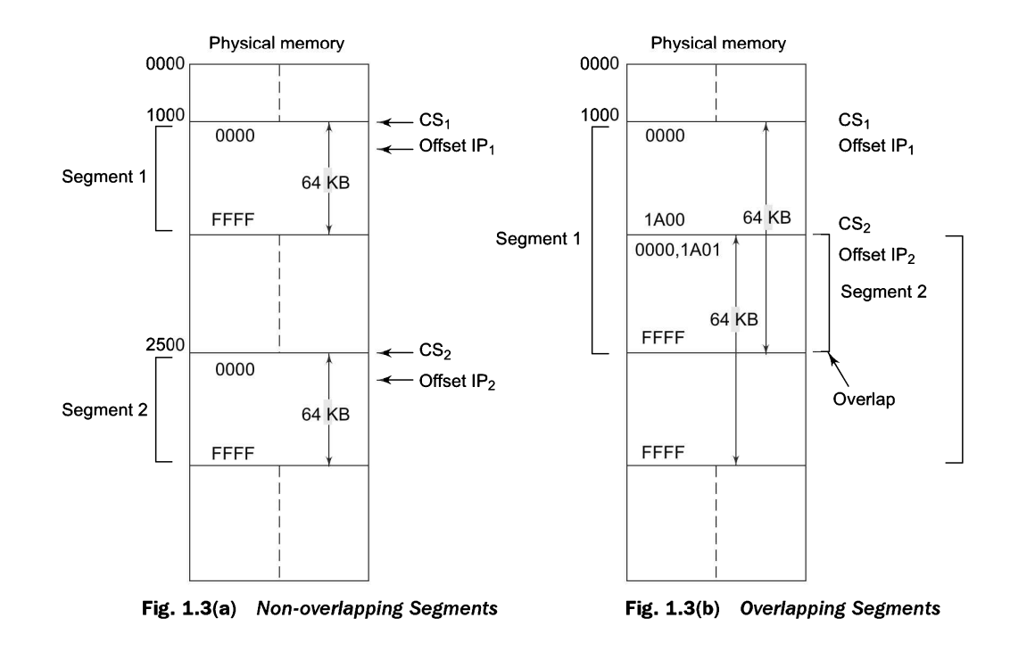

Slide 16
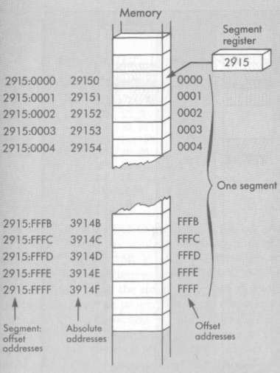
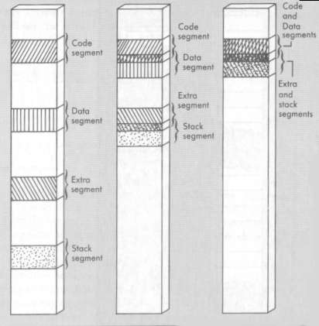
Memory Segmentation
.
Physical Address
Base Address
Offset
Effective Address
Use of segment registers, and pointers

Slide 17
Stack Addressing
The 8086 let you set aside an entire 64Kb segment as a stack.
The upper 16 bits of the starting address for this segment are kept in the stack segment register.
The stack pointer register holds the offset (16 bit).
The memory location where a word was most recently stored is called the top of stack.

Slide 18
Stack Addressing
The physical address for a stack read or a stack write is produced by adding the contents of the stack pointer register to the stack segment register.
Example:
SS = 5000H * 10H = 50000H
SP = FFE0H
SS + SP = 50000H + FFE0H
= 5FFE0H

Slide 19
Minimum and Maximum Modes
The minimum mode is selected by applying logic 1 to the MN / MX# input pin. This is a single microprocessor configuration.
The maximum mode is selected by applying logic 0 to the MN / MX# input pin. This is a multi micro processors configuration.

Slide 20
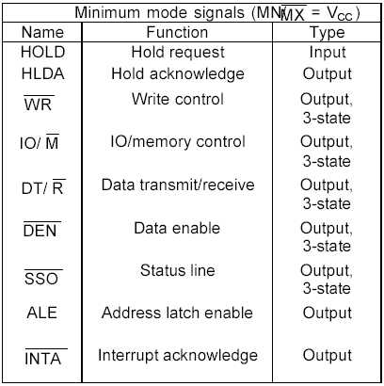
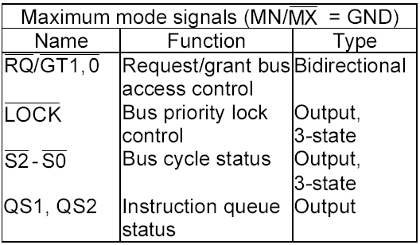
Difference : Min and Max mode

Slide 21
Minimum Mode Interface
When the Minimum mode operation is selected, the 8086 provides all control signals needed to implement the memory and I/O interface.
The minimum mode signal can be divided into the following basic groups : address/data bus, status, control, interrupt and DMA.
Address/Data Bus : these lines serve two functions. As an address bus is 20 bits long and consists of signal lines A₀ through A₁₉. A₁₉ represents the MSB and A₀ LSB. A 20bit address gives the 8086 a 1Mbyte memory address space. More over it has an independent I/O address space which is 64K bytes in length.

Slide 22
8086 Minimum-Mode Signals
Power supply
Vcc GND
INTR
_____
INTA
_____
TEST
NMI
RESET
HOLD
HLDA
Address / data bus
AD0-AD15,
A16/S3-A19/S6
ALE
____
BHE/S7
M/IO’
DT/R’
___
RD
___
WR
____
DEN
READY
Interrupt
interface
8086 MPU
Memory/IO
controls
DMA
interface
Mode
Select MN/MX’
CLK

Slide 23
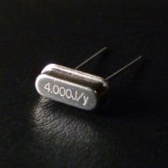
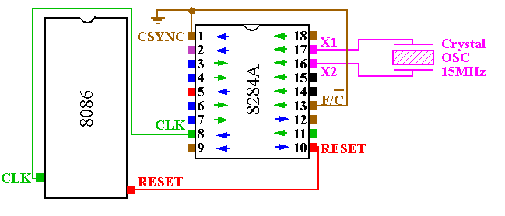
System Clock Generator-8284

Slide 24
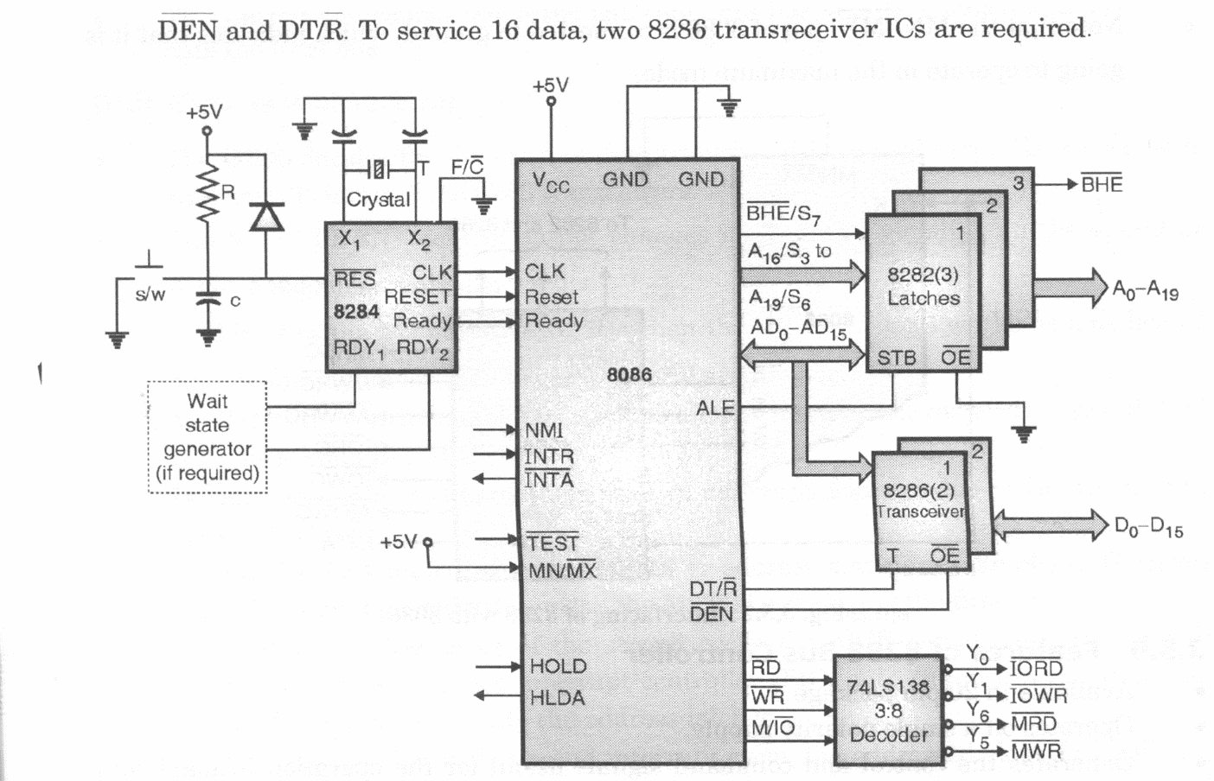
8086 Minimum-Mode

Slide 25
Read/Write Cycle Timing Diagram for Minimum Mode
T
1
T
2
T
3
T
W
T
4
T
1
ALE
ADD / STATUS
BHE
S
–
S
A
19
–
A
16
7
3
ADD / DATA
A
–
A
Valid data D
15
0
15
–
D
0
WR
DEN
DT / R

Slide 26
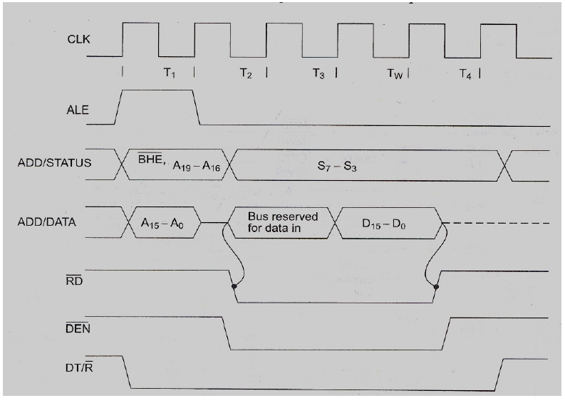

Slide 27
T1
T2
T3
T_{W}
T4
CLK
M/IO
ALE
ADDR/ DATA
MEMORY ACCESS TIME
A15-A0
RESERVED FOR DATA
VALID D15-D0
ADDR/ STATUS
A19-A16
RD/INTA
READY
DT/R
DEN

Slide 28
T1
T2
T3
T_{W}
T4
CLK
M/IO
ALE
ADDR/ DATA
A15-A0
DATA OUT (D15-D0)
ADDR/ STATUS
A19-A16
WR
READY
DT/R
DEN

Slide 29
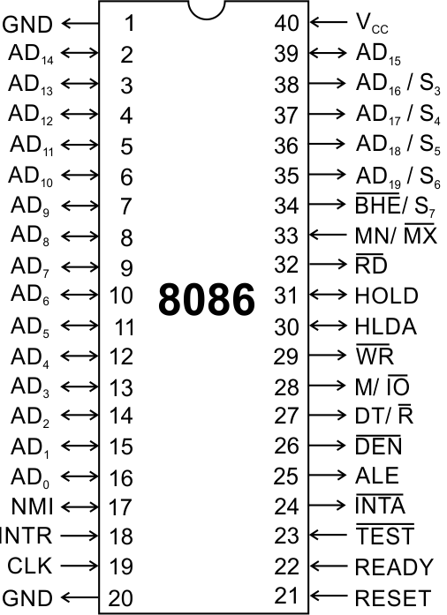
Pins and Signals
8086 Microprocessor
Min/ Max Pins
The 8086 microprocessor can work in two modes of operations : Minimum mode and Maximum mode.
In the minimum mode of operation the microprocessor do not associate with any co-processors and can not be used for multiprocessor systems.
In the maximum mode the 8086 can work in multi-processor or co-processor configuration.
Minimum or maximum mode operations are decided by the pin MN/ MX(Active low).
When this pin is high 8086 operates in minimum mode otherwise it operates in Maximum mode.

Slide 30
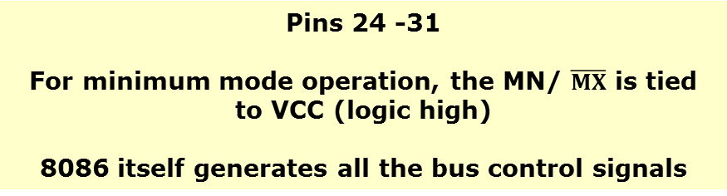



Pins and Signals
8086 Microprocessor
Minimum mode signals
 | (Data Transmit/ Receive) Output signal from the processor to control the direction of data flow through the data transceivers
 | (Data Enable) Output signal from the processor used as out put enable for the transceivers
ALE | (Address Latch Enable) Used to demultiplex the address and data lines using external latches
 | Used to differentiate memory access and I/O access. For memory reference instructions, it is high. For IN and OUT instructions, it is low.
 | Write control signal; asserted low Whenever processor writes data to memory or I/O port
 | (Interrupt Acknowledge) When the interrupt request is accepted by the processor, the output is low on this line.

Slide 31
Pins and Signals
8086 Microprocessor
Minimum mode signals
HOLD | Input signal to the processor form the bus masters as a request to grant the control of the bus. Usually used by the DMA controller to get the control of the bus.
HLDA | (Hold Acknowledge) Acknowledge signal by the processor to the bus master requesting the control of the bus through HOLD. The acknowledge is asserted high, when the processor accepts HOLD.

Slide 32
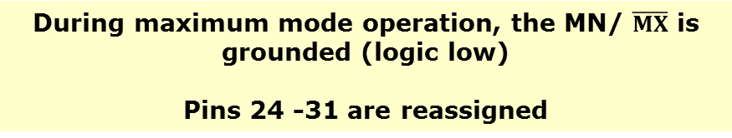
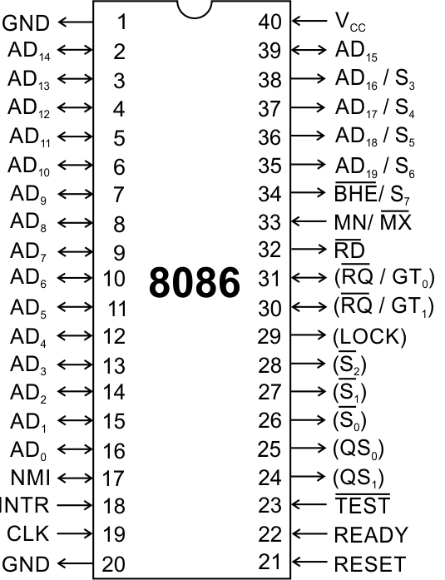
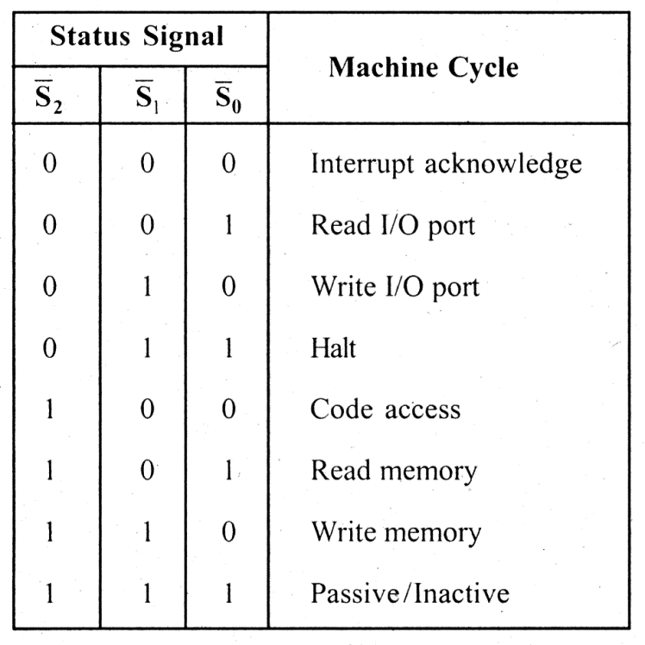
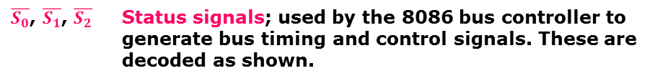
Pins and Signals
8086 Microprocessor
Maximum mode signals
 | Status signals; used by the 8086 bus controller to generate bus timing and control signals. These are decoded as shown.

Slide 33
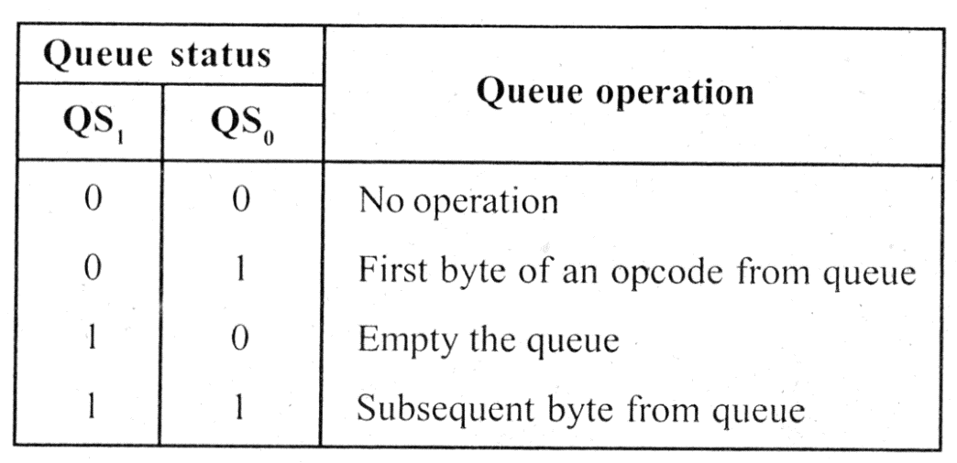
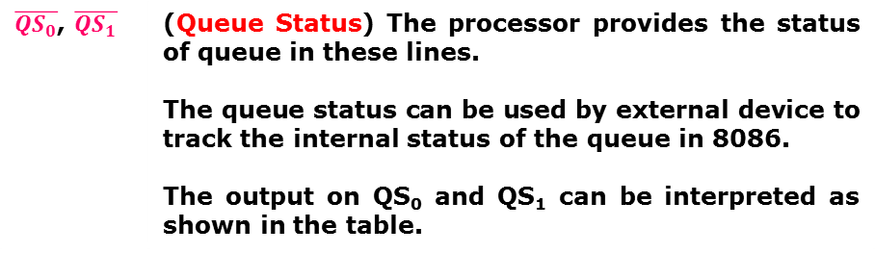
Pins and Signals
8086 Microprocessor
Maximum mode signals
 | (Queue Status) The processor provides the status of queue in these lines. The queue status can be used by external device to track the internal status of the queue in 8086. The output on QS₀ and QS₁ can be interpreted as shown in the table.

Slide 34
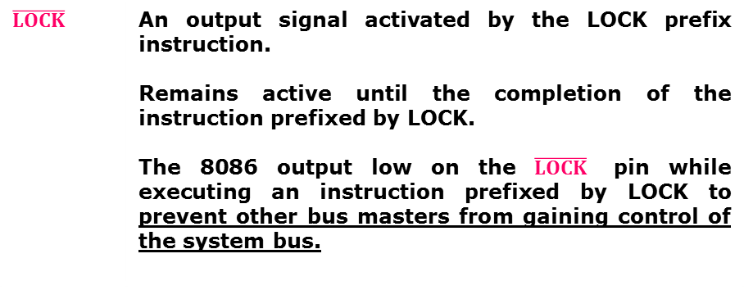
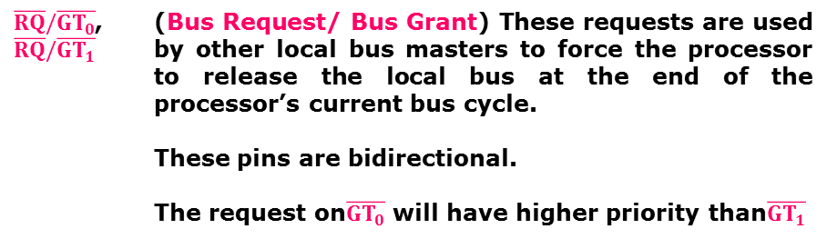
Pins and Signals
8086 Microprocessor
Maximum mode signals

Slide 35
Maximum Mode Interface
When the 8086 is set for the maximum-mode configuration, it provides signals for implementing a multiprocessor / coprocessor system environment.
By multiprocessor environment we mean that one microprocessor exists in the system and that each processor is executing its own program.
Usually in this type of system environment, there are some system resources that are common to all processors.
They are called as global resources. There are also other resources that are assigned to specific processors. These are known as local or private resources.

Slide 36
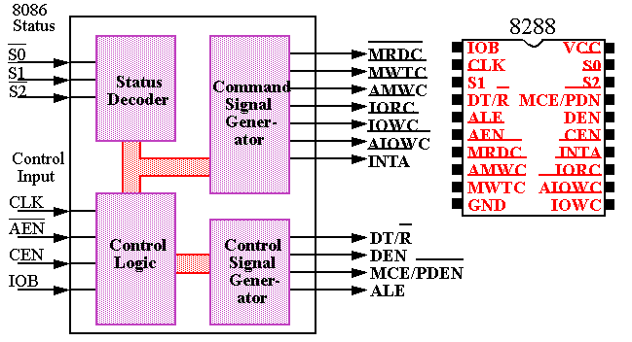
Bus Controller - 8288

Slide 37
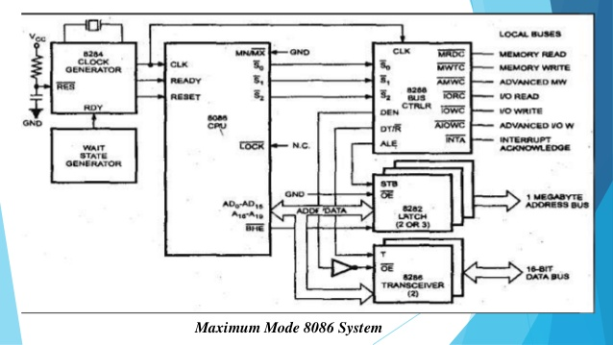

Slide 38
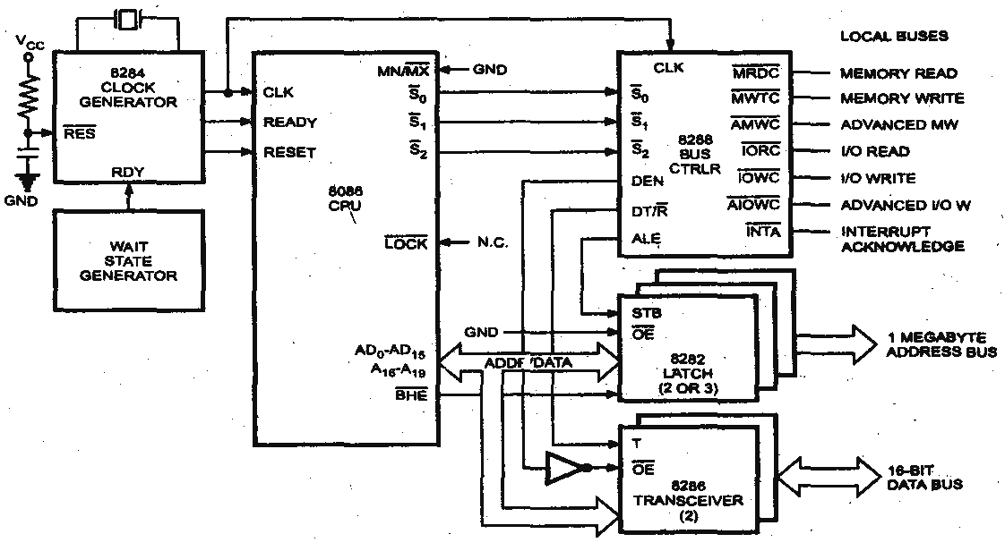
8086 Maximum Mode System

Slide 39
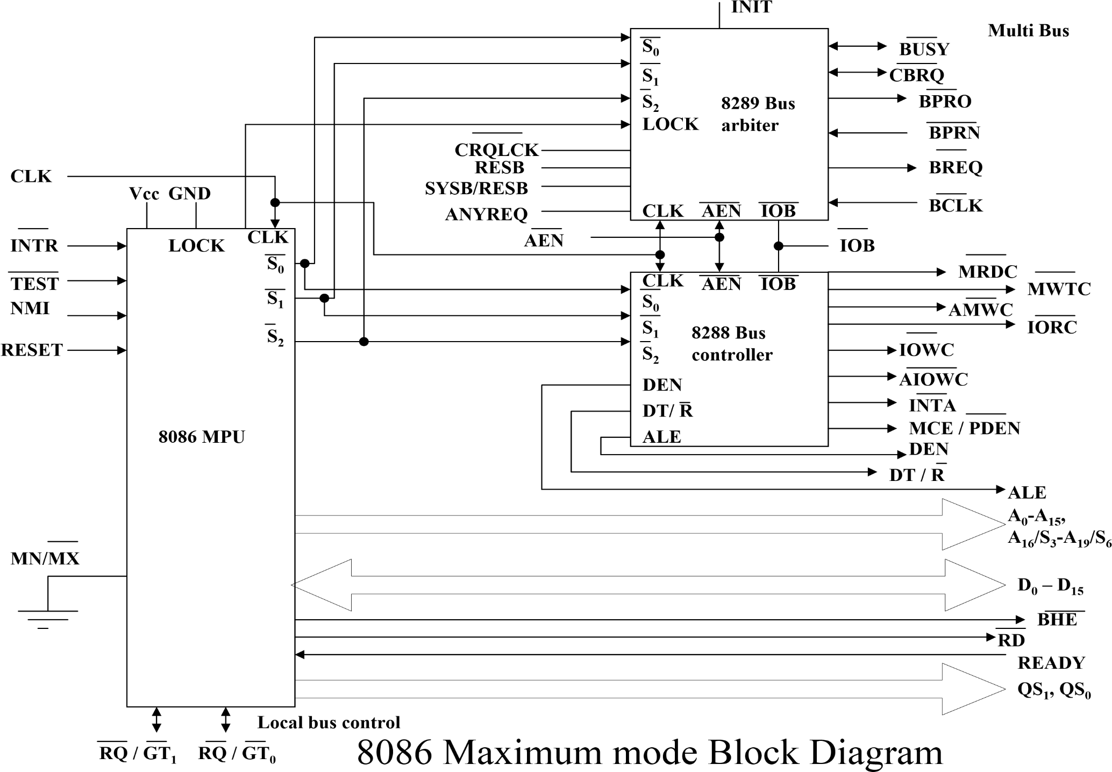

Slide 40
Memory Read Timing in Maximum mode.
One bus cycle
T
1
T
2
T
3
T
4
T
1
Clk
ALE
S2 – S0
Inactive
Active
Active
Add/Status
BHE, A
–
A
S
–
S
19
16
7
3
Add/Data
A
15
–
A
D
–
D
0
15
0
MRDC
DT / R
DEN

Slide 41
Memory Write Timing in Maximum mode.
One bus cycle
T
1
T
2
T
3
T
4
T
1
Clk
ALE
S
2
–
S
0
Active
Inactive
Active
ADD/STATUS
BHE
S
7
–
S
3
ADD/DATA
A
-
A
Data out D
15
0
15
–
D
0
AMWC or
A
IOW
C
MWTC or IOWC
DT / R
high
DEN

Slide 42
Assembler directives

Slide 43
Assemble Directives
8086 Microprocessor
Instructions to the Assembler regarding the program being executed.
Control the generation of machine codes and organization of the program; but no machine codes are generated for assembler directives.
Also called ‘pseudo instructions’
Used to :
› specify the start and end of a program
› attach value to variables
› allocate storage locations to input/ output data
› define start and end of segments, procedures, macros etc..

Slide 44
Assemble Directives
8086 Microprocessor
DB
DW
SEGMENT
ENDS
ASSUME
ORG
END
EVEN
EQU
PROC
FAR
NEAR
ENDP
SHORT
MACRO
ENDM
Define Byte
Define a byte type (8-bit) variable
Reserves specific amount of memory locations to each variable
Range : 00_{H} – FF_{H} for unsigned value; 00_{H} – 7F_{H} for positive value and 80_{H} – FF_{H} for negative value
General form : variable DB value/ values
Example:
LIST DB 7FH, 42H, 35H
Three consecutive memory locations are reserved for the variable LIST and each data specified in the instruction are stored as initial value in the reserved memory location

Slide 45
Assemble Directives
8086 Microprocessor
DB
DW
SEGMENT
ENDS
ASSUME
ORG
END
EVEN
EQU
PROC
FAR
NEAR
ENDP
SHORT
MACRO
ENDM
Define Word
Define a word type (16-bit) variable
Reserves two consecutive memory locations to each variable
Range : 0000_{H} – FFFF_{H} for unsigned value; 0000_{H} – 7FFF_{H} for positive value and 8000_{H} – FFFF_{H} for negative value
General form : variable DW value/ values
Example:
ALIST DW 6512H, 0F251H, 0CDE2H
Six consecutive memory locations are reserved for the variable ALIST and each 16-bit data specified in the instruction is stored in two consecutive memory location.

Slide 46
Assemble Directives
8086 Microprocessor
DB
DW
SEGMENT
ENDS
ASSUME
ORG
END
EVEN
EQU
PROC
FAR
NEAR
ENDP
SHORT
MACRO
ENDM
SEGMENT : Used to indicate the beginning of a code/ data/ stack segment
ENDS : Used to indicate the end of a code/ data/ stack segment
General form:
Segnam SEGMENT … … … … … … Segnam ENDS | Program code or Data Defining Statements
User defined name of the segment

Slide 47
Assemble Directives
8086 Microprocessor
DB
DW
SEGMENT
ENDS
ASSUME
ORG
END
EVEN
EQU
PROC
FAR
NEAR
ENDP
SHORT
MACRO
ENDM
Informs the assembler the name of the program/ data segment that should be used for a specific segment.
General form:
ASSUME segreg : segnam, .. , segreg : segnam
Segment Register
User defined name of the segment
Example:
ASSUME CS: ACODE, DS:ADATA | Tells the compiler that the instructions of the program are stored in the segment ACODE and data are stored in the segment ADATA

Slide 48
Assemble Directives
8086 Microprocessor
DB
DW
SEGMENT
ENDS
ASSUME
ORG
END
EVEN
EQU
PROC
FAR
NEAR
ENDP
SHORT
MACRO
ENDM
ORG (Origin) is used to assign the starting address (Effective address) for a program/ data segment
END is used to terminate a program; statements after END will be ignored
EVEN : Informs the assembler to store program/ data segment starting from an even address
EQU (Equate) is used to attach a value to a variable
Examples:
ORG 1000H | Informs the assembler that the statements following ORG 1000H should be stored in memory starting with effective address 1000_{H}
LOOP EQU 10FEH | Value of variable LOOP is 10FE_{H}
_SDATA SEGMENT ORG 1200H A DB 4CH EVEN B DW 1052H _SDATA ENDS | In this data segment, effective address of memory location assigned to A will be 1200_{H} and that of B will be 1202_{H} and 1203_{H}.

Slide 49
Assemble Directives
8086 Microprocessor
DB
DW
SEGMENT
ENDS
ASSUME
ORG
END
EVEN
EQU
PROC
ENDP
FAR
NEAR
SHORT
MACRO
ENDM
PROC Indicates the beginning of a procedure
ENDP End of procedure
FAR Intersegment call
NEAR Intrasegment call
General form
procname PROC[NEAR/ FAR] … … … RET procname ENDP | Program statements of the procedure Last statement of the procedure
User defined name of the procedure

Slide 50
Assemble Directives
8086 Microprocessor
DB
DW
SEGMENT
ENDS
ASSUME
ORG
END
EVEN
EQU
PROC
ENDP
FAR
NEAR
SHORT
MACRO
ENDM
Examples:
ADD64 PROC NEAR … … … RET ADD64 ENDP | The subroutine/ procedure named ADD64 is declared as NEAR and so the assembler will code the CALL and RET instructions involved in this procedure as near call and return
CONVERT PROC FAR … … … RET CONVERT ENDP | The subroutine/ procedure named CONVERT is declared as FAR and so the assembler will code the CALL and RET instructions involved in this procedure as far call and return

Slide 51
Assemble Directives
8086 Microprocessor
DB
DW
SEGMENT
ENDS
ASSUME
ORG
END
EVEN
EQU
PROC
ENDP
FAR
NEAR
SHORT
MACRO
ENDM
Reserves one memory location for 8-bit signed displacement in jump instructions
Example:
JMP SHORT AHEAD | The directive will reserve one memory location for 8-bit displacement named AHEAD

Slide 52
Assemble Directives
8086 Microprocessor
DB
DW
SEGMENT
ENDS
ASSUME
ORG
END
EVEN
EQU
PROC
ENDP
FAR
NEAR
SHORT
MACRO
ENDM
MACRO Indicate the beginning of a macro
ENDM End of a macro
General form:
macroname MACRO[Arg1, Arg2 ...] … … … macroname ENDM | Program statements in the macro
User defined name of the macro

Slide 53
To write an assembly language program to perform division of 16-bit unsigned number by 8-bit unsigned number.
.MODEL SMALL
DATA SEGMENT
OPR1 DW 2C58H
OPR2 DB 56H
RESQ DB ?
RESR DB ?
DATA ENDS
ASSUME CS : CODE, DS : DATA
CODE SEGMENT
START:MOV AX, DATA
MOV DS, AX
MOV AX, OPR1
DIV OPR2
MOV RESQ, AL
MOV RESR, AH
MOV AH, 4CH
INT 21H
CODE ENDS
END START

Slide 54
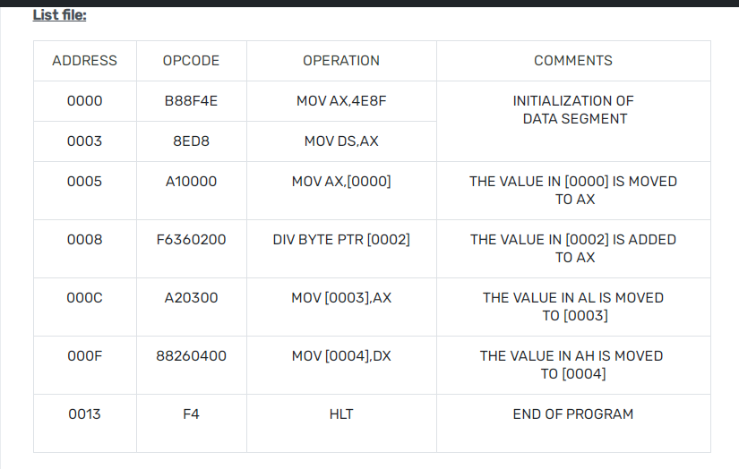

Slide 55
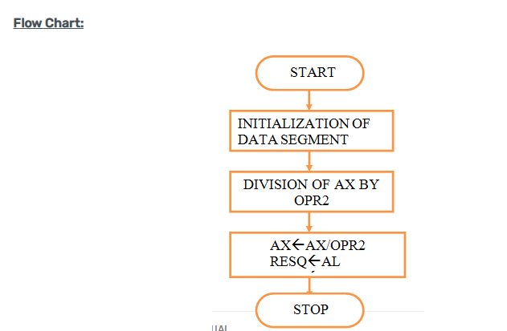

Slide 56
